Slide 1
Problem Solving
Unit 2

Slide 2
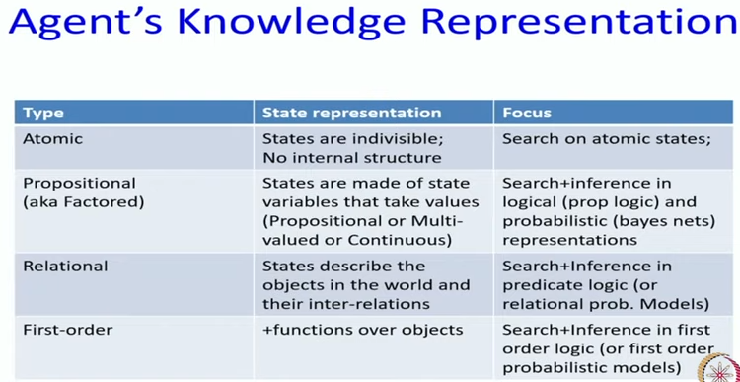

Slide 3
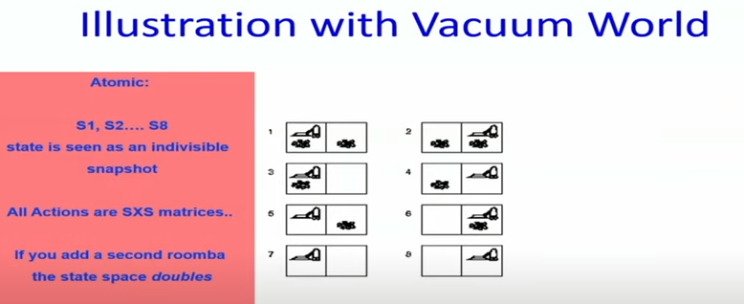

Slide 4
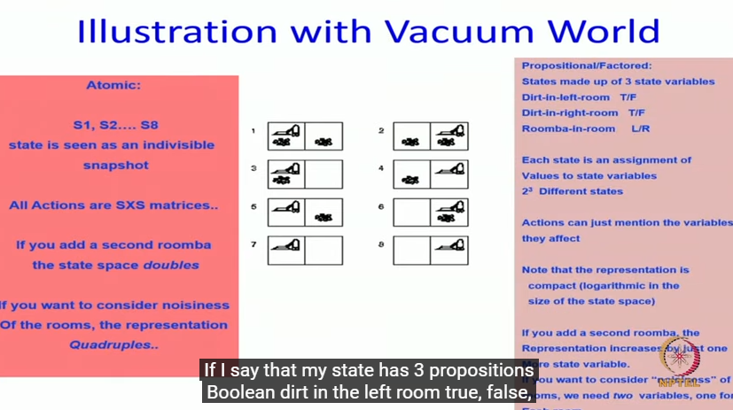

Slide 5
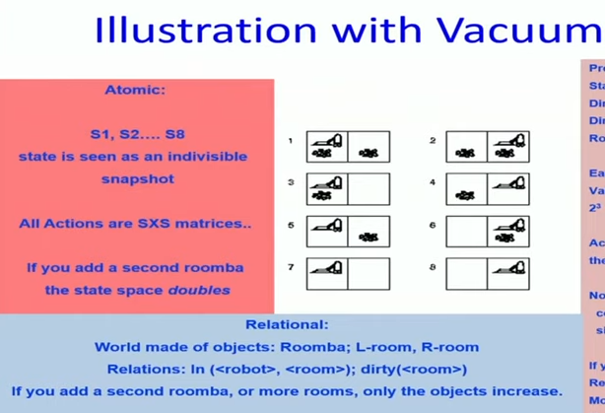

Slide 6
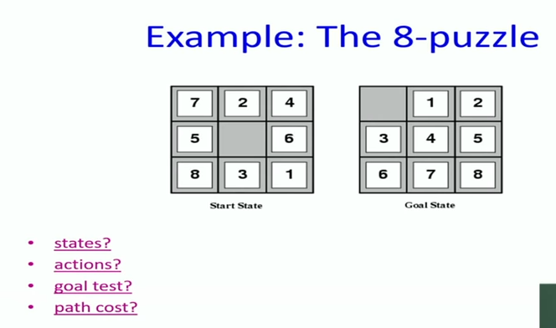

Slide 7
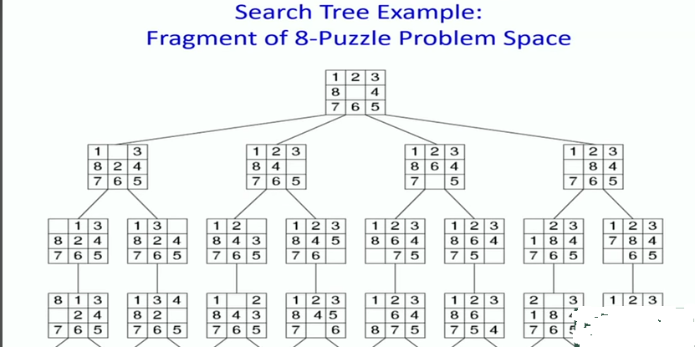

Slide 8
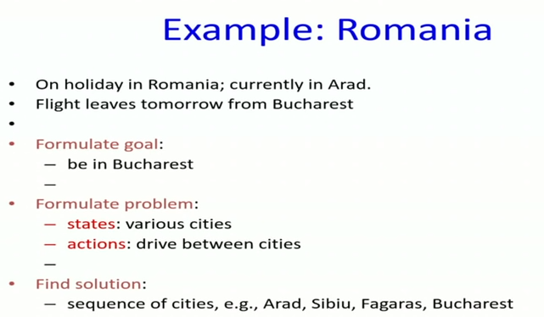

Slide 9
Problem Solving by Searching
The reflex agents are known as the simplest agents because they directly map states into actions.
Unfortunately, these agents fail to operate in an environment where the mapping is too large to store and learn.
Goal-based agent, on the other hand, considers future actions and the desired outcomes.
one type of goal-based agent known as a problem-solving agent,
which uses atomic representation with no internal states visible to the problem
-solving algorithms.

Slide 10
Problem-solving agent
The problem-solving agent preforms precisely by defining problems and its several solutions.
According to psychology, “a problem-solving refers to a state where we wish to reach to a definite goal from a present state or condition.”
According to computer science, a problem-solving is a part of artificial intelligence which encompasses a number of techniques such as algorithms, heuristics to solve a problem.
Therefore, a problem-solving agent is a goal-driven agent and focuses on satisfying the goal.

Slide 11
Problem-solving agent
Goal formulation:
Setting goals help the agent organize its behavior by limiting the objectives that the agent is trying to achieve and hence the actions it needs to consider.
This Goal formulation based on the current situation and the agent’s performance measure is the first step in problem solving.
Problem formulation:
We consider the agent’s goal to be a set of states. The agent’s task is to find out actions in the present and in the future that could reach the goal state from the present state.
Problem formulation is the process of deciding what actions and states to consider, given a goal.

Slide 12
Search?
After Goal formulation and problem formulation, the agent has to look for a sequence of actions that reaches the goal.
This process is called Search.
A search algorithm takes a problem as input and returns a sequence of actions as output.
After the search phase, the agent has to carry out the actions that are recommended by the search algorithm.
This final phase is called execution phase.
Formulate — Search — Execute
Thus the agent has a formulate, search and execute design to it.

Slide 13
Well-defined Problems and Solutions
The problem can be defined formally in five components:
Initial State
Actions
Transition Model
Goal Test
Path Cost

Slide 14
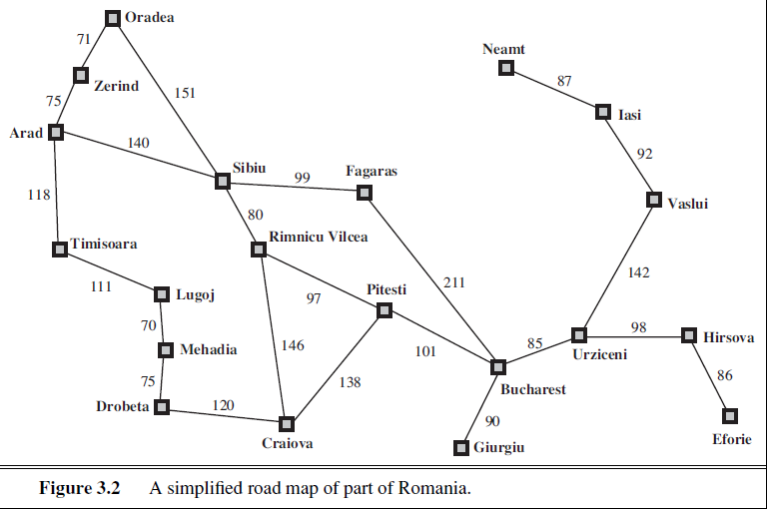

Slide 15
Initial State
The first component that describes the problem is the initial state that the agent starts in.
For example, if a taxi agent needs to get to location(B) but the taxi is currently at location(A) then the initial state of the problem would be location(A). In(A)
Actions
A description of the possible actions available to the agent.
Given a state s, Actions(s) returns the set of actions that can be executed in s. We say that each of these actions is applicable in s.
For Example, from the state In(Aurangabad}, the applicable actions are { Go(Ahmednagar), Go(Nashik), Go(Pune)}

Slide 16
Transition Model
A description of what each action does which is called the transition model.
It is specified by a function Result(s , a) that returns the state that results from doing action a in state s.
The term successor is also used to refer any state reachable from a give state by a single action.
For Example : RESULT(In (Aurangabad), Go (Pune)) = In (Pune)
The initial state, actions and transition model together define the state space of a problem.
State Space is a set of all states reachable from the initial state by any sequence of actions.
The state space forms a graph in which the nodes are states and the links between the nodes are actions.
A path in the state space is a sequence of states connected by a sequence of actions.

Slide 17
Goal Test
The goal test determines whether a given state is a goal state or not.
Sometimes there is an explicit set of possible goal states and the test simply checks whether the given state is one of them.
The agent’s goal is the singleton set {In (Pune)}
Sometimes the goal is specified by an abstract property rather than an explicitly enumerated set of states.
For example, In Chess, the goal is to reach a state called “Checkmate”, where the opponent’s king is under attack and can’t scape.

Slide 18
Path Cost:
A path cost which is a function that assigns a numeric cost to each path.
The problem solving agent chooses a cost function that reflects its own performance measure.
For Example, the path cost can be the distance between the two cities.
The cost of a path can be sum of the costs of the individual actions along the path.
The Step cost of taking action a in state s to reach to state s’ is denoted by c(s, a, s’)

Slide 19
Solution:
The solution to the problem is an action sequence that leads from initial state to goal state.
The solution quality is measured by the path cost function.
An optimal solution has the lowest path cost among all the solutions.

Slide 20
Formulating Problem:
Formulation of a problem is like a model – an abstract mathematical Description.
Abstract State : In(Pune)
Abstract Action: Driving

Slide 21
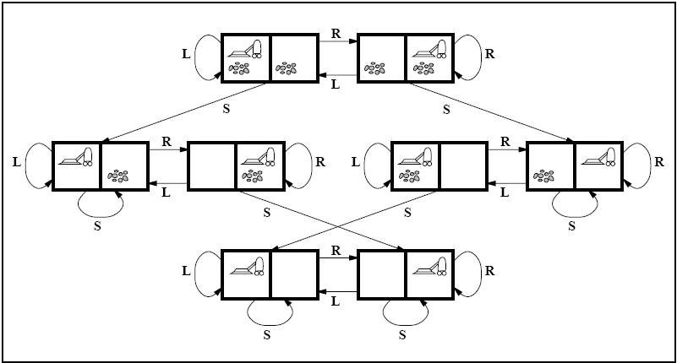
An Example Problem Formulation
Let us take the example of vacuum world that was introduced in the starting of this series, There is a vacuum cleaner agent and it can move left or right and its jump is to suck up the dirt from the floor.
State space for vacuum world.

Slide 22
Vacuum Cleaner Problem
The problem for vacuum world can be formulated as follows:
States: The state is determined by both the agent location and the dirt location. The agent is in one of two locations, each of which might or might not contain dirt. Therefore, there are 2 x 2² = 8 possible world states.
A larger environment would have n x 2 to the power of n states.
Initial State: Any state can be assigned as the initial state in this case.
Action: In this environment there are three actions, Move Left , Move Right , Suck up the dirt.
Transition Model: All the actions have expected effects, except for when the agent is in leftmost square and the action is Left, when the agent is in rightmost square and the action is Right and the square is clean when the action is to Suck.

Slide 23
Vacuum Cleaner Problem
The problem for vacuum world can be formulated as follows:
Goal Test: Goal test checks whether all the squares are clean.
Path Cost: Each step costs 1, so the path cost is the number of steps in the path.
.

Slide 24
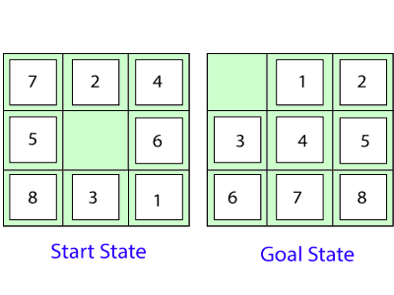
8 Puzzle Problem

Slide 25
8 Puzzle Problem
The problem formulation is as follows:
States: It describes the location of each numbered tiles and the blank tile.
Initial State: We can start from any state as the initial state.
Actions: Here, actions of the blank space is defined, i.e., either left, right, up or down
Transition Model: It returns the resulting state as per the given state and actions.
Goal test: It identifies whether we have reached the correct goal-state.
Path cost: The path cost is the number of steps in the path where the cost of each step is 1.

Slide 26
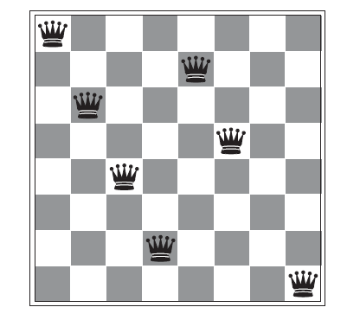
8-queens problem

Slide 27
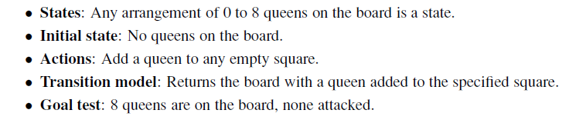
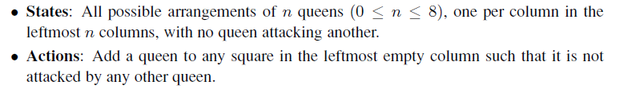
8-queens problem: Problem Formulation

Slide 28
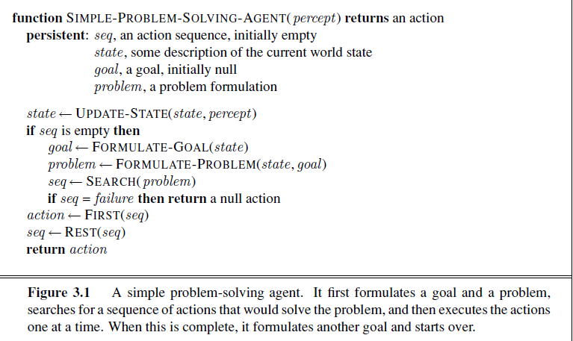

Slide 29
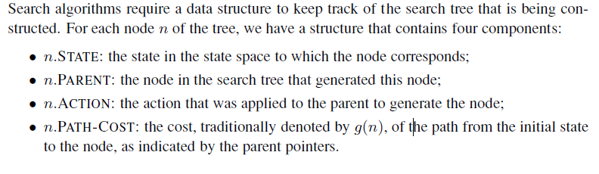
Infrastructure for search algorithms

Slide 30
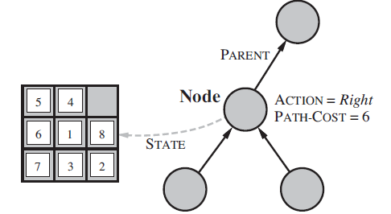
Typical node data structure includes:
State at this node
Parent node
Operator applied to get to this node
Depth of this node (number of operator applications since initial state)
Cost of the path (sum of each operator application so far)

Slide 31
Measuring problem-solving performance
Completeness
Guarantees finding a solution whenever one exists
Time complexity
How long (worst or average case) does it take to find a solution? Usually measured in terms of the number of nodes expanded
Space complexity
How much space is used by the algorithm? Usually measured in terms of the maximum size of the “nodes” list during the search
Optimality/Admissibility
If a solution is found, is it guaranteed to be an optimal one? That is, is it the one with minimum cost?

Slide 32
Uninformed Search:
Uninformed search is a class of general-purpose search algorithms which operates in brute force-way.
Uninformed search algorithms do not have additional information about state or search space other than how to traverse the tree, so it is also called blind search.
Following are the various types of uninformed search algorithms:
Breadth-first Search
Depth-first Search
Depth-limited Search
Iterative deepening depth-first search
Uniform cost search
Bidirectional Search

Slide 33
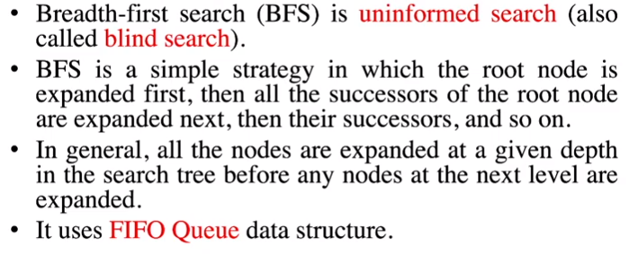
Breadth First Search

Slide 34
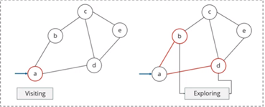
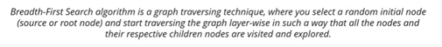
Breadth First Search

Slide 35
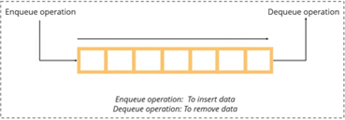
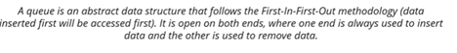
Queue:

Slide 36
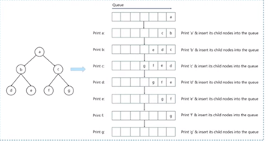

Slide 37
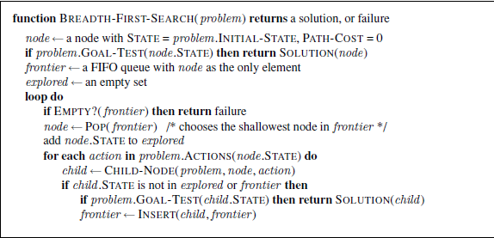

Slide 38
Advantages:
BFS will provide a solution if any solution exists.
If there are more than one solutions for a given problem, then BFS will provide the minimal solution which requires the least number of steps.

Slide 39
Disadvantages:
It requires lots of memory since each level of the tree must be saved into memory to expand the next level.
BFS needs lots of time if the solution is far away from the root node.

Slide 40
Performance Measures of BSF
Time Complexity: Time Complexity of BFS algorithm can be obtained by the number of nodes traversed in BFS until the shallowest Node. Where the d= depth of shallowest solution and b is a node at every state.
T (b) = 1+b²+b³+.......+ b^{d}= O (b^{d})
Space Complexity: Space complexity of BFS algorithm is given by the Memory size of frontier which is O(b^{d}).
Completeness: BFS is complete, which means if the shallowest goal node is at some finite depth, then BFS will find a solution.
Optimality: BFS is optimal if path cost is a non-decreasing function of the depth of the node.

Slide 41
Depth-first Search
Depth-first search is a recursive algorithm for traversing a tree or graph data structure.
It is called the depth-first search because it starts from the root node and follows each path to its greatest depth node before moving to the next path.
DFS uses a stack data structure for its implementation.
The process of the DFS algorithm is similar to the BFS algorithm.

Slide 42
Advantage:
DFS requires very less memory as it only needs to store a stack of the nodes on the path from root node to the current node.
It takes less time to reach to the goal node than BFS algorithm (if it traverses in the right path).

Slide 43
Disadvantage:
There is the possibility that many states keep re-occurring, and there is no guarantee of finding the solution.
DFS algorithm goes for deep down searching and sometime it may go to the infinite loop.

Slide 44
Completeness: DFS search algorithm is complete within finite state space as it will expand every node within a limited search tree.
Time Complexity: Time complexity of DFS will be equivalent to the node traversed by the algorithm. It is given by:
T(n)= 1+ n²+ n³ +.........+ n^{m}=O(n^{m})
Where, m= maximum depth of any node and this can be much larger than d (Shallowest solution depth)
Space Complexity: DFS algorithm needs to store only single path from the root node, hence space complexity of DFS is equivalent to the size of the fringe set, which is O(bm).
Optimal: DFS search algorithm is non-optimal, as it may generate a large number of steps or high cost to reach to the goal node.

Slide 45
Uniform Cost Search
Uniform-cost search is a searching algorithm used for traversing a weighted tree or graph. This algorithm comes into play when a different cost is available for each edge.
The primary goal of the uniform-cost search is to find a path to the goal node which has the lowest cumulative cost. g(n)
Uniform-cost search expands nodes according to their path costs form the root node. It can be used to solve any graph/tree where the optimal cost is in demand.
A uniform-cost search algorithm is implemented by the priority queue. It gives maximum priority to the lowest cumulative cost.
Uniform cost search is equivalent to BFS algorithm if the path cost of all edges is the same.

Slide 46
Uniform Cost Search
Algorithm Steps:
Insert Root Node into the queue.
Repeat till queue is not empty:
Remove the next element with the highest priority from the queue.
If the node is a destination node, then print the cost and the path and exit
Insert all the children of removed elements into the queue with their cumulative cost as their priorities.

Slide 47
Uniform Cost Search
Advantages:
Uniform cost search is optimal because at every state the path with the least cost is chosen.
Disadvantages:
It does not care about the number of steps involve in searching and only concerned about path cost. Due to which this algorithm may be stuck in an infinite loop.

Slide 48
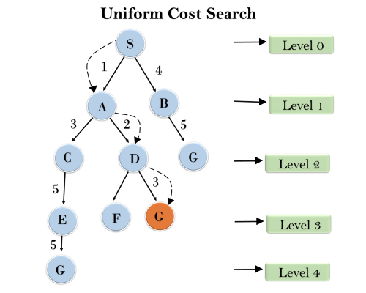

Slide 49
Uniform Cost Search
Completeness:
Uniform-cost search is complete, such as if there is a solution, UCS will find it.
Time Complexity:
Let C* is Cost of the optimal solution, and ε is each step to get closer to the goal node. Then the number of steps is = C*/ε+1. Here we have taken +1, as we start from state 0 and end to C*/ε.
Hence, the worst-case time complexity of Uniform-cost search is O(b^{1 + [C*/ε]})/.
Space Complexity:
The same logic is for space complexity so, the worst-case space complexity of Uniform-cost search is O(b^{1 + [C*/ε]}).

Slide 50
Depth-Limited Search Algorithm:
A depth-limited search algorithm is similar to depth-first search with a predetermined limit.
Depth-limited search can solve the drawback of the infinite path in the Depth-first search.
In this algorithm, the node at the depth limit will treat as it has no successor nodes further.
Depth-limited search can be terminated with two Conditions of failure:
Standard failure value: It indicates that problem does not have any solution.
Cutoff failure value: It defines no solution for the problem within a given depth limit.

Slide 51
Depth-Limited Search Algorithm:
Advantages:
Depth-limited search is Memory efficient.
Disadvantages:
Depth-limited search also has a disadvantage of incompleteness.
It may not be optimal if the problem has more than one solution.

Slide 52
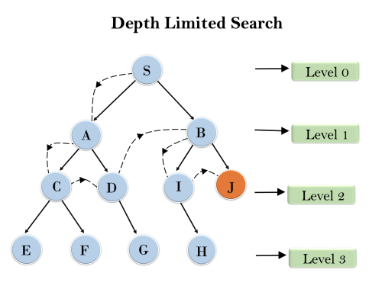
Depth-Limited Search Algorithm:

Slide 53
Depth-Limited Search Algorithm:
Completeness: DLS search algorithm is complete if the solution is above the depth-limit.
Time Complexity: Time complexity of DLS algorithm is O(b^{ℓ}).
Space Complexity: Space complexity of DLS algorithm is O(b×ℓ).

Slide 54
Iterative deepening depth-first Search:
The iterative deepening algorithm is a combination of DFS and BFS algorithms.
This search algorithm finds out the best depth limit and does it by gradually increasing the limit until a goal is found.
This algorithm performs depth-first search up to a certain "depth limit", and it keeps increasing the depth limit after each iteration until the goal node is found.
This Search algorithm combines the benefits of Breadth-first search's fast search and depth-first search's memory efficiency.
The iterative search algorithm is useful uninformed search when search space is large, and depth of goal node is unknown.

Slide 55
Iterative deepening depth-first Search:
Advantages:
It combines the benefits of BFS and DFS search algorithm in terms of fast search and memory efficiency.
Disadvantages:
The main drawback of IDDFS is that it repeats all the work of the previous phase.

Slide 56
Iterative deepening depth-first Search:
Completeness:
This algorithm is complete is if the branching factor is finite.
Time Complexity:
Let's suppose b is the branching factor and depth is d then the worst-case time complexity is O(b^{d}).
Space Complexity:
The space complexity of IDDFS will be O(bd).
Optimal:
IDDFS algorithm is Optimal.

Slide 57
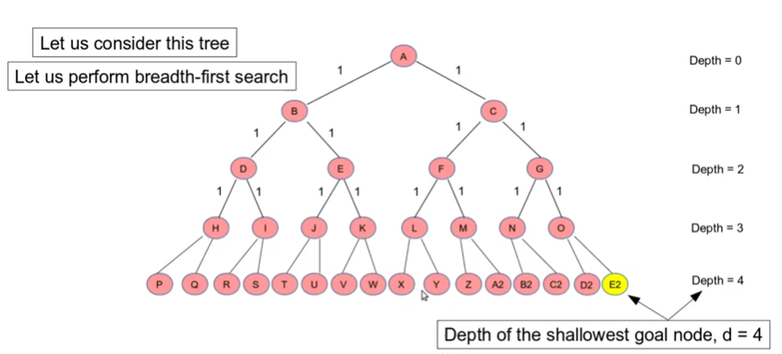

Slide 58
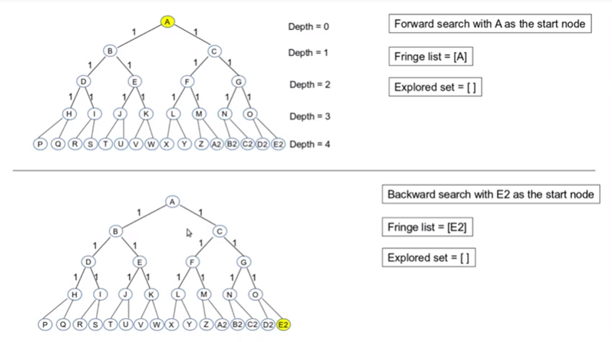

Slide 59
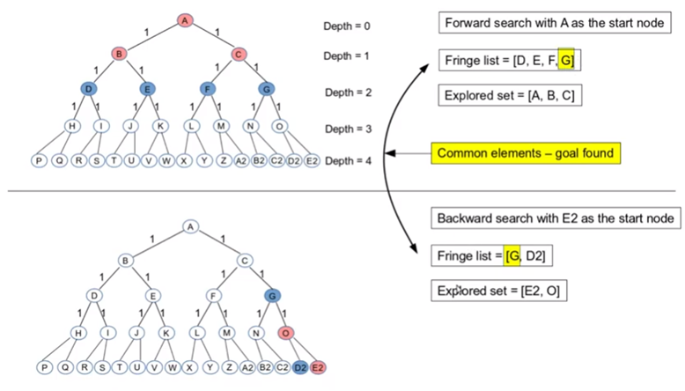

Slide 60
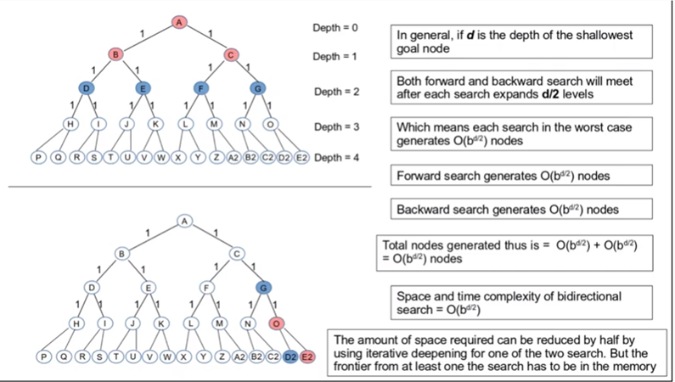

Slide 61
Greedy Best-First Search
Greedy Best-First Search is an AI search algorithm that attempts to find the most promising path from a given starting point to a goal.
It prioritizes paths that appear to be the most promising, regardless of whether or not they are actually the shortest path.
The algorithm works by evaluating the cost of each possible path and then expanding the path with the lowest cost.
This process is repeated until the goal is reached.

Slide 62
Greedy Best-First Search
Greedy best-first search is an informed search algorithm where the evaluation function is strictly equal to the heuristic function, disregarding the edge weights in a weighted graph.
To get from a start node to a target node, the lowest value resulting from some heuristic function, h(x), is considered as the successive node to traverse to.
The goal is to choose the quickest and shortest path to the target node.

Slide 63
Evaluation Function
The evaluation function, f(x), for the greedy best-first search algorithm is the following:
f(x) = h(x)
Here, the evaluation function is equal to the heuristic function. Since this search disregards edge weights, finding the lowest-cost path is not guaranteed.

Slide 64
Heuristic Function
A heuristic function, h(x), evaluates the successive node based on how close it is to the target node.
In other words, it chooses the immediate low-cost option. As this is the case, however, it does not necessarily find the shortest path to the goal.

Slide 65
The Algorithm
Initialize a tree with the root node being the start node in the open list.
If the open list is empty, return a failure, otherwise, add the current node to the closed list.
Remove the node with the lowest h(x) value from the open list for exploration.
If a child node is the target, return a success. Otherwise, if the node has not been in either the open or closed list, add it to the open list for exploration.

Slide 66
Disadvantages of Greedy Best-First Search:
Inaccurate Results: Greedy Best-First Search is not always guaranteed to find the optimal solution, as it is only concerned with finding the most promising path.
Local Optima: Greedy Best-First Search can get stuck in local optima, meaning that the path chosen may not be the best possible path.
Heuristic Function: Greedy Best-First Search requires a heuristic function in order to work, which adds complexity to the algorithm.
Lack of Completeness: Greedy Best-First Search is not a complete algorithm, meaning it may not always find a solution if one is exists. This can happen if the algorithm gets stuck in a cycle or if the search space is a too much complex.

Slide 67
A* Algorithm:
A* Algorithm is basically an artificial intelligence problem used for the pathfinding (from point A to point B) and the Graph traversals.
This algorithm is flexible and can be used in a wide range of contexts.
The A* search algorithm uses the heuristic path cost, the starting point’s cost, and the ending point.

Slide 68
Why A* Algorithm?
This Algorithm is the advanced form of the BFS algorithm (Breadth-first search), which searches for the shorter path first than, the longer paths.
It is a complete as well as an optimal solution for solving path and grid problems.
Optimal – find the least cost from the starting point to the ending point.
Complete – It means that it will find all the available paths from start to end.

Slide 69
Basic concepts of A*
Where
g (n) : The actual cost path from the start node to the current node.
h ( n) : The actual cost path from the current node to goal node.
f (n) : The actual cost path from the start node to the goal node.
For the implementation of A* algorithm we have to use two arrays namely OPEN and CLOSE.

Slide 70
OPEN:
An array that contains the nodes that have been generated but have not been yet examined till yet.
CLOSE:
An array which contains the nodes which are examined.

Slide 71
Algorithm
1:Firstly, Place the starting node into OPEN and find its f (n) value.
2: Then remove the node from OPEN, having the smallest f (n) value. If it is a goal node, then stop and return to success.
3: Else remove the node from OPEN, and find all its successors.
4: Find the f (n) value of all the successors, place them into OPEN, and place the removed node into CLOSE.
5: Goto Step-2.
6: Exit.

Slide 72
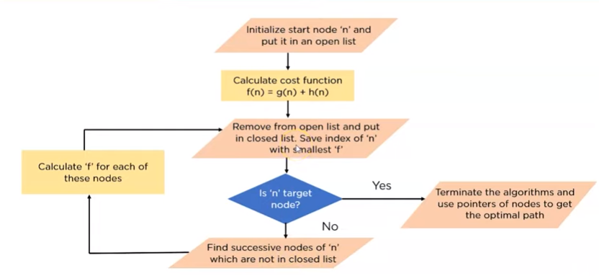

Slide 73
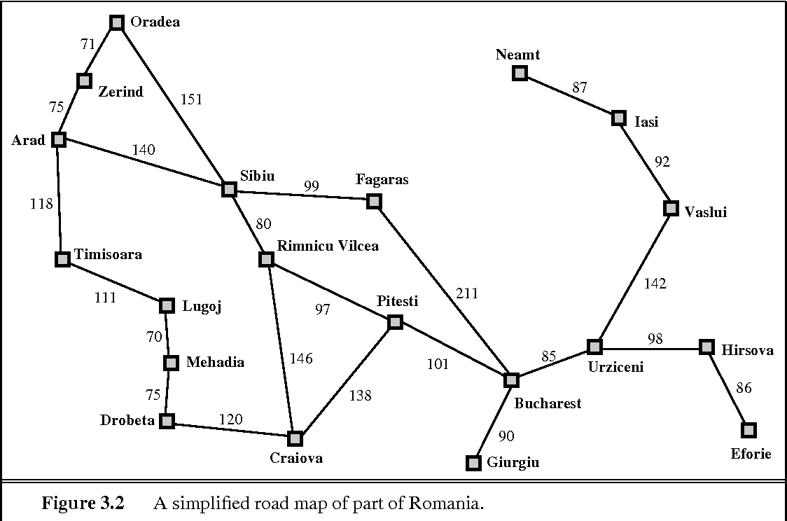

Slide 74
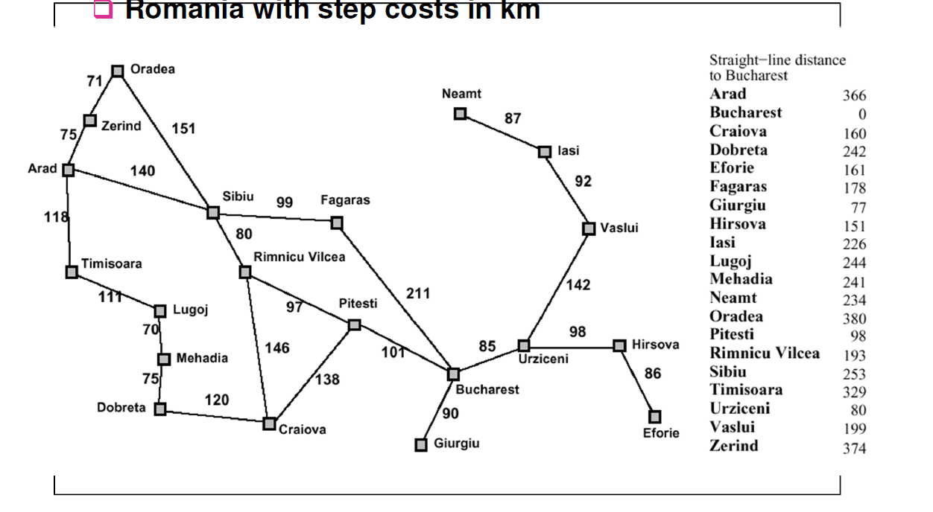



Slide 75
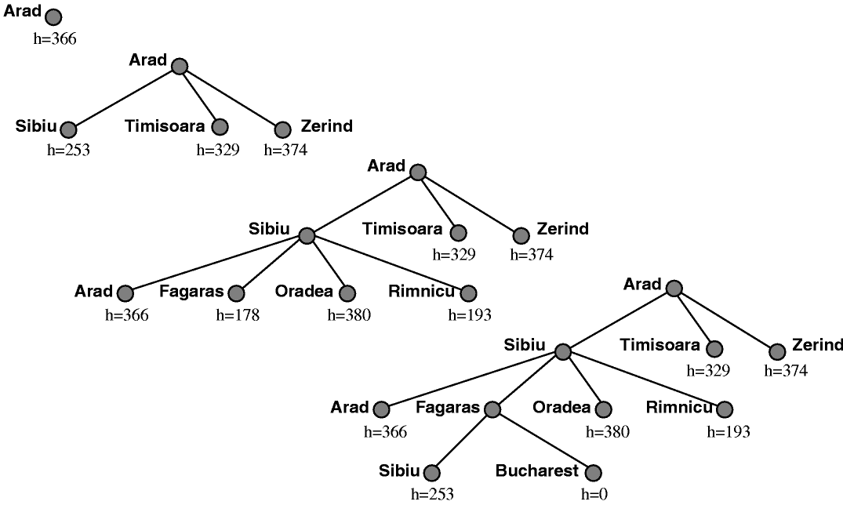




Slide 76
Advantages of A* Algorithm
It is fully complete and optimal.
This is the best one of all the other techniques. We use to solve all the complex problems through this algorithm.
The algorithm is optimally efficient, i.e., there is no other optimal algorithm that is guaranteed to expand fewer nodes than A*.

Slide 77
Disadvantages of A* Algorithm
This algorithm is complete if the branching factor is finite of the algorithm and every action has a fixed cost.
The speed execution of A* search is highly dependent on the accuracy of the heuristic algorithm that is used to compute h (n) and is a bit slower than other algorithms.

Slide 78
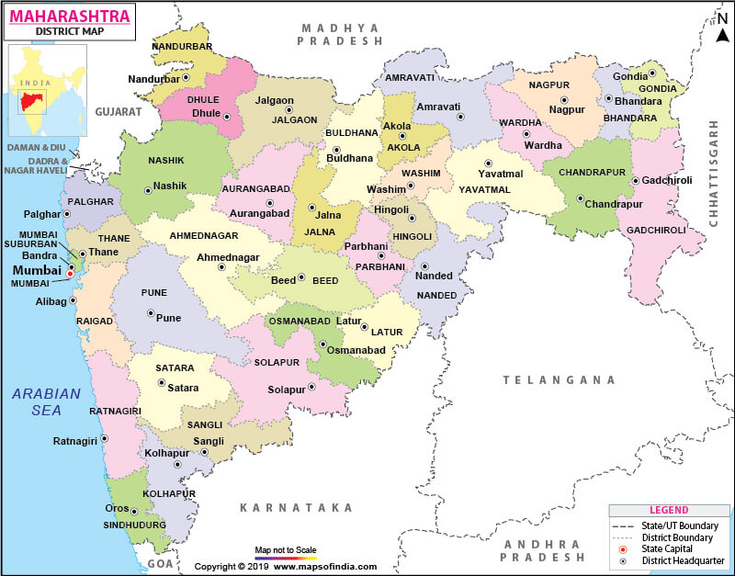

Slide 79
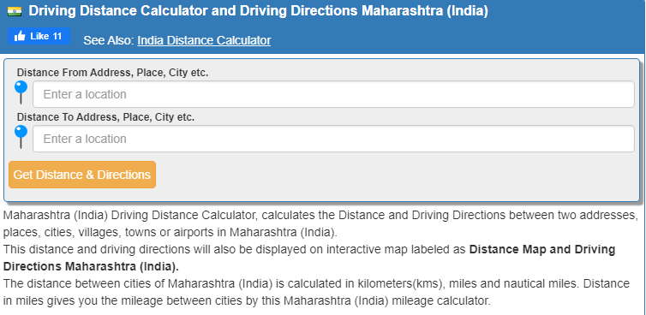
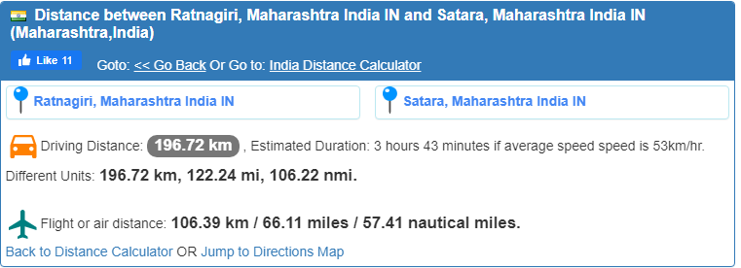

Slide 80
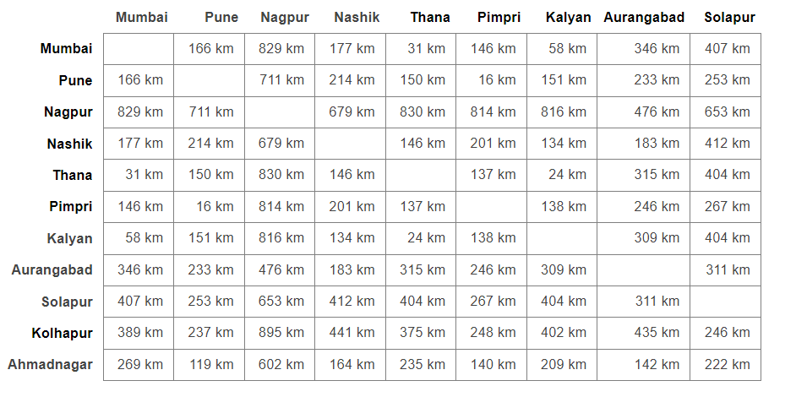

Slide 81
Sample Questions
What is problem solving agent?
What is search? What are the different phases of problem solving?
Explain five components involved in problem formulation.
Which are the different problem solving performance measures?
What is difference between uninformed and informed search?
Solve the graph problem using Breadth first search, depth first search, Uniform cost search.
Explain Bidirectional search with example.
Explain Iterative deepening search with example.

Slide 82
What is Informed Heuristic search?
Solve graph problems using greedy best-first search and A* Algorithm
What is Heuristic function. Which two heuristic function are used in 8-puzzle problem

